Slide 1
IBIS [Model] Connection Figures
5 April 2016

Slide 2
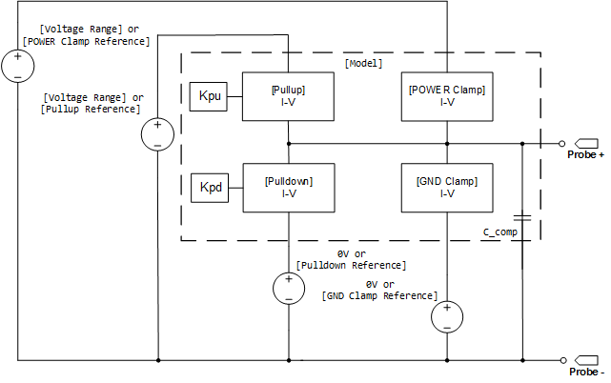
[Model] Connections, Bare Die

Slide 3
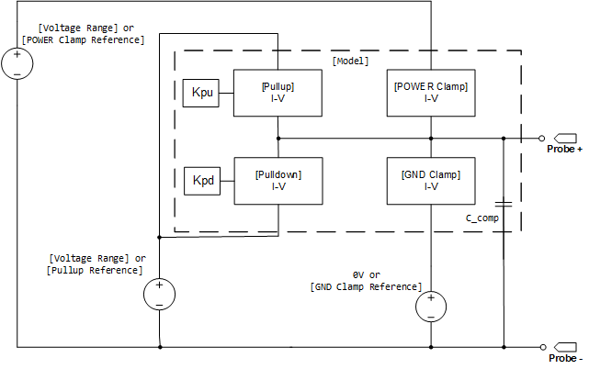
ECL [Model] Connections, Bare Die

Slide 4
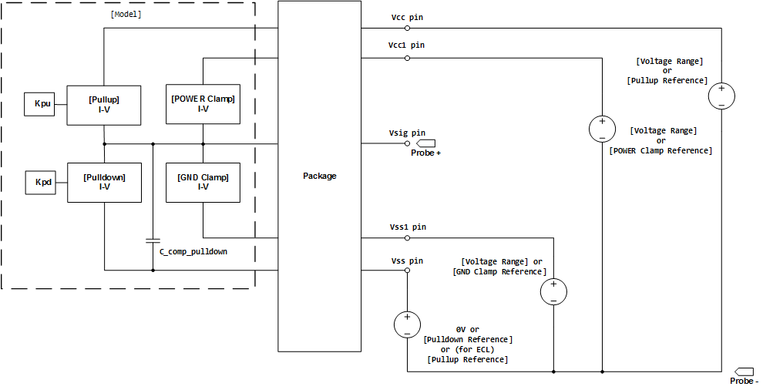
[Model] Connections, with Package

